Slide 1

How to build a startup if you can’t code
Even if you can
Powered by StartitUp.co
By: Edward Liu
ed@startitup.co
Notes:
Hello everyone, I am Edward Liu, the CEO and Co-founder of StartitUp. I was also the CEO of National Division in Groupon Taiwan.
Well, this applies to everyone, but just of more interest to the non-technical folks.

Slide 2
I have a great idea, I need to…
Notes:
When I ask people about what they think they should do next, they always tell me that…

Slide 3
Build it
Notes:
They need to build it.

Slide 4

This is where most people get stuck.

Slide 5
Starting today…
Drop the Build-First Mentality
Hacker
Notes:
Even if you are able to build it, you could be building something nobody wants. You’d probably want to validate it first.

Slide 6
Start your business today. All you need are:
Determination
Passion
Short-Sightedness
Notes:
Use your talent. Don’t do things that make you compete with your weakest point, which is technical.
You don’t need to code.

Slide 7
“Do stuff that doesn’t scale”
Deliver your solution manually (on a smaller scale)
Reduce development time (Use what’s available)
A “dumb” version of your MVP
Notes:
You guys are so smart, just be dumb for once. Be like Forrest Gump dumb.
Always think about the smallest or dumbest thing you can do. Imagine doing your business without the benefit of the internet.
This is not a MVP. MVP is still a product.

Slide 8
Adopt the Service-First Mentality
Hustler
Stop building, start doing!
Notes:
Means you build businesses that focuses on delivering services. Things you can do manually.
It’s kind of like, you don’t hear people say start a website or app, but start a business.
Instead of waiting for the product to deliver the solution for you, deliver it yourself.

Slide 9
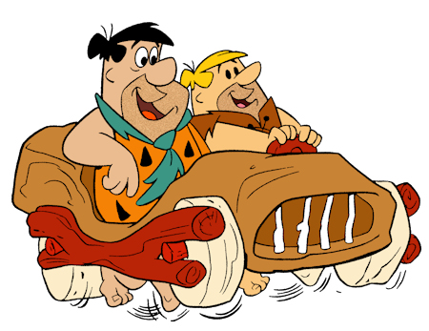
MVB- Minimum Viable Business
Skip product. Go straight for the money.
Notes:
Imagine building your business when there was no internet. Imagine when this is 20 years ago. How would you do it?
People nowadays are spoiled with the idea that you have all these programming languages that you need to build a business.

Slide 10



Don’t go after the tech-heavy ideas
Don’t f*ck with data!
Notes:
Don’t mess with data, which means don’t build a service where you need to manipulate data.

Slide 11
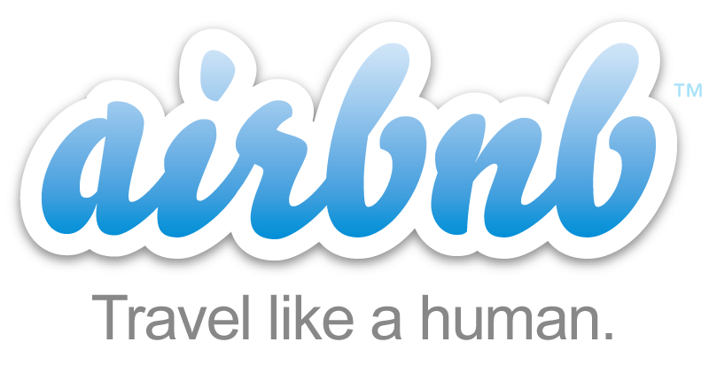


Go after service-heavy ideas
Online-to-Offline Ideas
(o2o)
Notes:
Do what you’re good at. Manipulate people. Ask people to do shit. And then you sell that shit.
Online to offline means it’s something that people are doing offline already, and you it online, on a bigger scale. However, to start, you want to “offline”. You still want a simple landing page or maybe a Wordpress website or something, but you’re doing literally no coding.

Slide 12
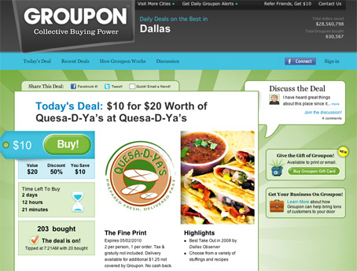
Groupon
Their MVB: Wordpress Blog
They didn’t bother building a product.
They went straight to the merchants and asked them for discounts.
Once they got that, they post the deals on their Wordpress blog.
Users get what they want.
Money starts rolling in.
Notes:
Andrew Mason was a music major and he didn’t know how to code.
He put up a Wordpress blog, went out and talked to restaurants.

Slide 13

Uber
MVB: Start a Private Driver Firm (A crew of 4 or something)
Once you have revenue, use that revenue to build the mobile app.

Slide 14
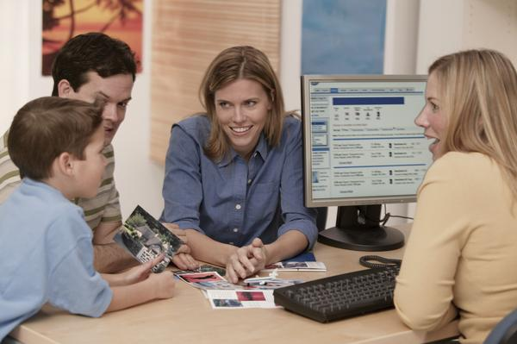
airbnb
MVB: Ask your friends for their empty rooms and list them.
Again, build your website once you are able to validate this idea and make some revenue.

Slide 15
Great o2o Businesses
Vayable – Tours by locals
Exec – Book a house cleaning
Taskrabbit – Get help from your neighbors
Zaarly – Local service providers
Monster – Jobs site
Match – Dating website
Codecademy – Learn to code
There are still a lot of other opportunities!

Slide 16
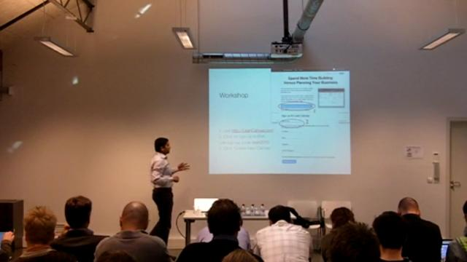
Other ideas to jumpstart your business
Organize workshops, seminars, events, parties, sell stuff, teach stuff. Be creative.

Slide 17
So when should I start building?
Answer: When you run out of bandwidth with your business (meaning you are already making money).
Notes:
Or you could start building when you have gotten traction or have made some money – when you already have a business.

Slide 18
Save yourself from wasted time, money, and sleepless nights
Think Dumb.
Powered by StartitUp.co
By: Edward Liu
ed@startitup.co
Notes:
Having the service-first mentality will help you validate your idea, get traction, and help you make money in the process.
It’s also way more fun to go out and talk to people instead of sitting in front of your computer 10 hours a day.
Compare this to making a product nobody wants, and crying yourself to sleep. Every night.
You know what to do.

